Slide 1

Computer Networks
Application Layer

Slide 2
Topic of the day
IP Addressing Protocols
Domain Name System - DNS
Network Management Protocol
Dynamic Host Configuration Protocol - DHCP
MIME Quiz

Slide 3
IP Addressing Protocols - DNS
Domain Name System
While IP addresses are crucial for network communication, they are not easy to memorize.
Domain names are created to make server addresses more user-friendly.
Domain names such as http://www.cisco.com are user-friendly addresses associated with the IP address of a specific server.
However, computers still need the actual numeric address before they can communicate.

Slide 4
Domain Name System
The DNS protocol allows for the dynamic translation of a domain name into the correct IP address.
The DNS protocol communications using a single format called a message.

Slide 6
DNS Message Format
DNS supports different types of records. Some of these record types are:
o A - An end device IPv4 address
o NS - An authoritative name server
o AAAA - An end device IPv6 address (pronounced quad-A)
o MX - A mail exchange record
DNS servers will first look at its own records to resolve the name. If the server is unable to resolve the name using its locally stored records, it relays the query to other servers.
The response is then forwarded to the requesting client.
The DNS Client service on Windows PCs also stores previously resolved names in memory.
ipconfig /displaydns displays all of the cached DNS entries on Windows.

Slide 8
DNS Hierarchy
The DNS protocol uses a hierarchical system, with the root at the top and branches below. The naming structure is broken down into small, manageable zones.
Each DNS server is only responsible for managing name-to-IP mappings for that small portion of the DNS structure.
Requests for zones not stored in a specific DNS server are forwarded to other servers for translation.
Top-level domains represent either the type of domain or the country of origin.
Examples of top-level domains are:
o .com - a business or industry
o .org - a non-profit organization
o .au - Australia
o .co - Colombia

Slide 9
Notes:
Ipconfig/displaydns

Slide 10
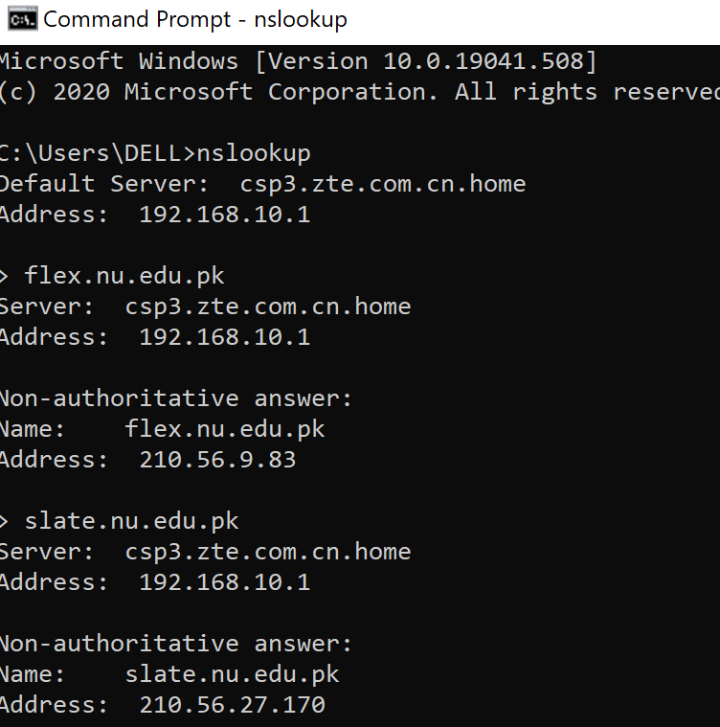
Nslookup Command
Allows the user to manually place DNS queries.
It can also be used to troubleshoot name resolution issues.
Has many options available for extensive testing and verification of the DNS process.
DDNS: Dynamic Domain Name System
DNS Caching

Slide 11
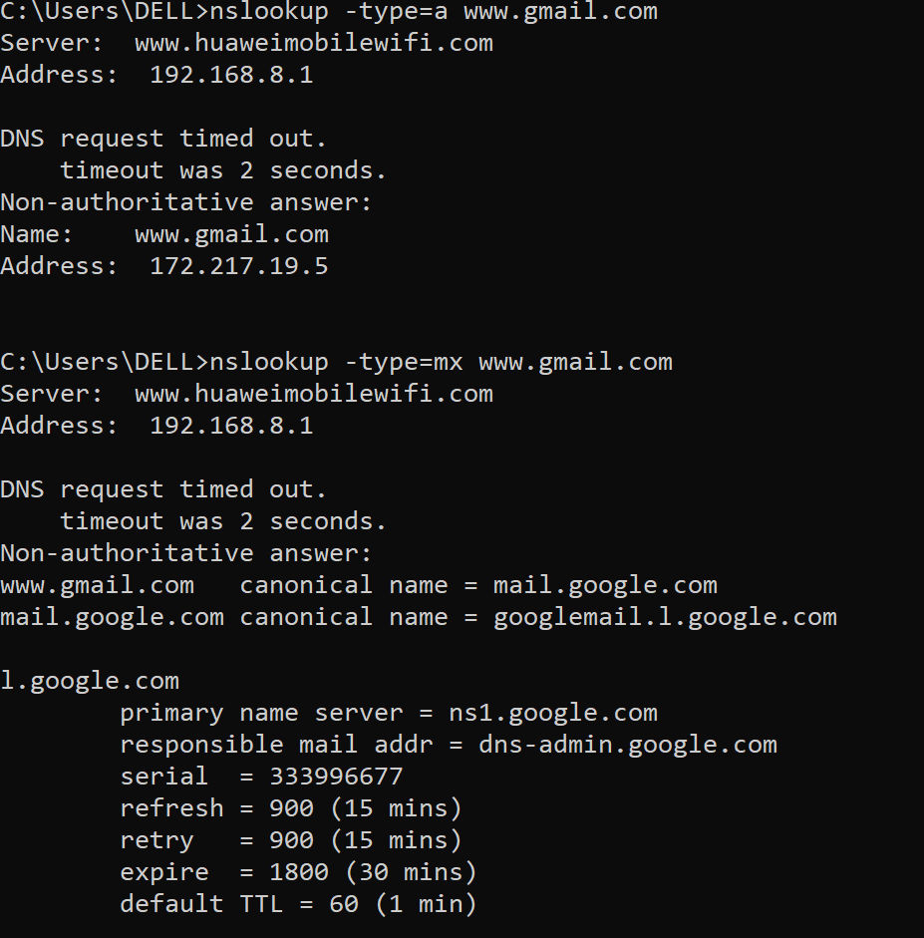
Notes:
Authoritative answer – This is the answer that originates from the DNS Server which has the information about the zone file. Non-authoritative answer – When a nameserver is not in the list for the domain you did a lookup on. Different port – By default, the DNS servers use port 53.

Slide 12
DNS Security Issues
Major attacks:
DNS Hijacking
Cache Poisoning/ DNS Spoofing
DNS DOS attack
DNS SEC

Slide 13
Additional Topics
Types of DNS
Iterative DNS
Reverse DNS
Recursive DNS

Slide 14
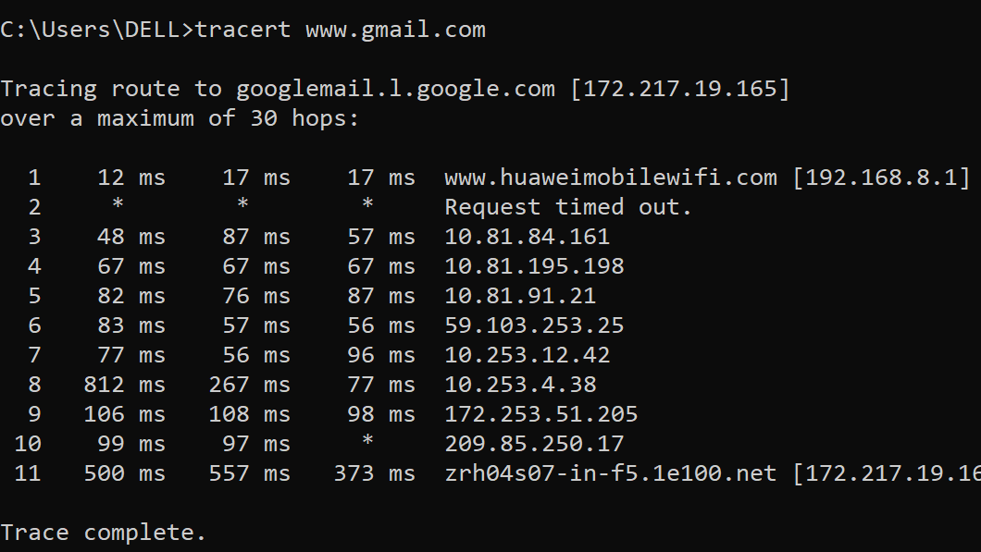

Slide 15
Dynamic Host Configuration Protocol
Computers need network addresses to communicate over a network.
Additional crucial information includes gateway address, subnet mask, and DNS server.
Manually configuring end devices is not scalable. DHCP allows for automated distribution of network information.
DHCP-distributed addresses are leased for a set period of time.
Addresses are returned to the pool for reuse when no longer in use.
DHCP supports IPv4 and DHCPv6 supports IPv6.
Notes:
The DHCP employs a connectionless service model, using the User Datagram Protocol (UDP). It is implemented with two UDP port numbers for its operations which are the same as for the bootstrap protocol (BOOTP). UDP port number 67 is the destination port of a server, and UDP port number 68 is used by the client.

Slide 16

DHCP (Dynamic Host Configuration Protocol)
Network management protocol
Used to dynamically assign an Internet Protocol (IP) address.
Allocates TCP/IP configuration information to DHCP clients.
DHCP automates and centrally manages these configurations assigning IP addresses to all network devices.
DHCP can be implemented on small local networks, as well as large enterprise networks.
Versions of DHCP are available for use in IP version 4 (IPv4) and IP version 6 (IPv6).
Notes:
DHCP will assign new IP addresses in each location when devices are moved from place to place, which means network administrators do not have to manually configure each device with a valid IP address or reconfigure the device with a new IP address if it moves to a new location on the network.
IPv6 became an industry standard in 2017 -- nearly 20 years after its specifications were first published. While the adoption rate of IPv6 was slow, by July 2019, more than 29% of Google users were making inquiries using IPv6.

Slide 17
Configuration information includes
Subnet mask information,
Default gateway IP addresses and
Domain name system (DNS) addresses.
DHCP is a client-server protocol
Servers manage a pool of unique IP addresses, as well as information about client configuration parameters, and assign addresses out of those address pools.
DHCP-enabled clients send a request to the DHCP server whenever they connect to a network.

Slide 18
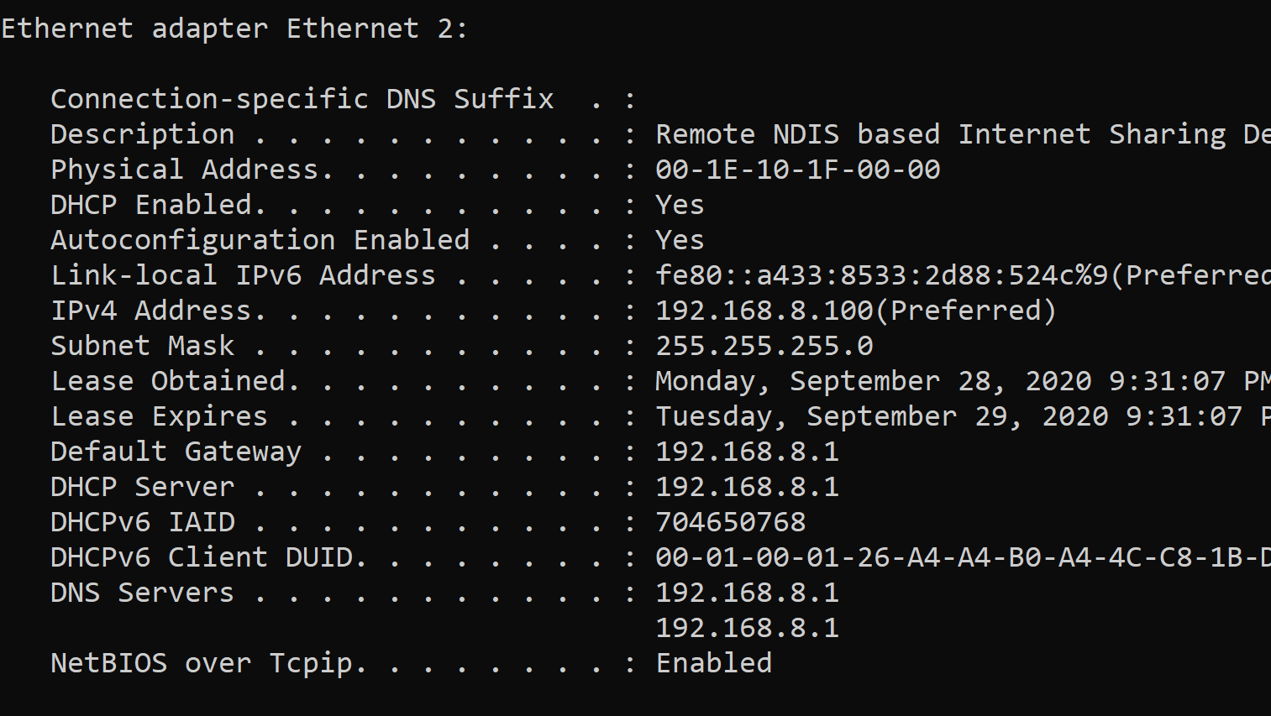

Slide 19
Components
DHCP is made up of numerous components, such as the
DHCP server,
client and
relay.
The DHCP server:
typically either a server or router, is a networked device that runs on the DHCP service.
The DHCP server holds IP addresses, as well as related information pertaining to configuration.
The DHCP client:
is a device -- such as a computer or phone -- that can connect to a network and communicate with a DHCP server.
The DHCP relay:
will manage requests between DHCP clients and servers.
Typically, relays are used when an organization has to handle large or complex networks.
Other components include the
IP address pool,
subnet,
lease and
DHCP communications protocol.

Slide 20
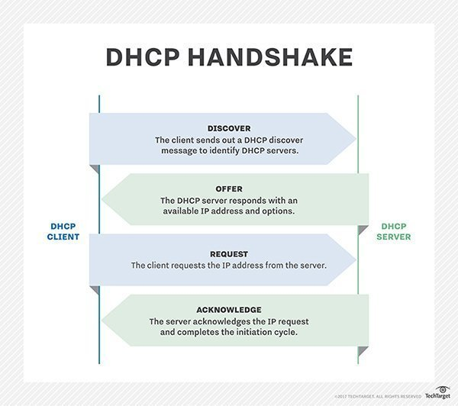

Slide 21
DHCP Operation
A DHCP client goes through the following basic steps to request an IP:
o The client broadcasts a DHCPDISCOVER.
o A DHCP server replies with a DHCPOFFER message
o The client sends a DHCPREQUEST message to the server it wants to use (in case of multiple offers).
A client may also choose to request an address that it had previously been allocated by the server.
The server returns a DHCPACK message to confirm the lease has been finalized.

Slide 22
The server would respond with a DHCPNAK if the offer is no longer valid
Leases must be renewed before its expiration through another DHCPREQUEST.
DHCPv6 has a similar set of messages:
o SOLICIT
o ADVERTISE
o INFORMATION REQUEST
o REPLY

Slide 23
Clients configured with DHCP broadcast a request to the DHCP server and request network configuration information for the local network to which they're attached.
Query broadcasted by client immediately after booting up.
The DHCP server responds to the client request by providing IP configuration information previously specified by a network administrator.
This includes a specific IP address, as well as a time period -- also called a lease -- for which the allocation is valid.
When refreshing an assignment, a DHCP client requests the same parameters, but the DHCP server may assign a new IP address based on policies set by administrators.
DHCP clients can also be configured on an Ethernet interface.

Slide 24
A DHCP server manages a record of all the IP addresses it allocates to network nodes.
If a node is relocated in the network, the server identifies it using its Media Access Control (MAC) address, which prevents the accidental configuration of multiple devices with the same IP address.
Configuring a DHCP server also requires the creation of a configuration file, which stores network information for clients.

Slide 25
If network administrators want a DHCP server to provide addressing to multiple subnets on a given network, they must configure DHCP relay services located on interconnecting routers that DHCP requests have to cross.
These agents relay messages between DHCP clients and servers located on different subnets.

Slide 26
DHCP Security
DHCP is not a routable protocol, nor is it a secure one.
DHCP lacks any built-in mechanism that would enable clients and servers to authenticate each other.
Both are vulnerable to deception -- one computer pretending to be another -- and to attack, where rogue clients can exhaust a DHCP server's IP address pool.
Man in the Middle Attack
Memory Corruption Vulnerability
Notes:
One of the key vulnerabilities of DHCP has been the use of so-called man in the middle (MitM) attacks, in which the attacker secretly intercepts and relays messages between two parties who believe they are communicating directly with each other.
DHCP servers have also been the subject of multiple memory corruption vulnerabilities. In these, attackers have targeted the Windows DHCP Server service. When successful, the attacks can lead to a full compromise of Microsoft Active Directory (AD). One such vulnerability, patched by Microsoft, was the Common Vulnerabilities and Exposures (CVE)-2019-0725 Windows DHCP Server Remote Code Execution (RCE) Vulnerability.

Slide 27
References
https://searchnetworking.techtarget.com/definition/DHCP#:~:text=DHCP%20runs%20at%20the%20application,name%20system%20(DNS)%20addresses.
https://ns1.com/resources/dns-types-records-servers-and-queries#:~:text=The%20most%20common%20DNS%20record,and%20its%20corresponding%20IPv6%20address.
DHCP CLI Commands
CVE Database

